Slide 1
GO Team Meeting
SCHOOL NAME
MTG DATE

Slide 2
Agenda
Call to Order
Roll Call; Establish Quorum
Action Items
  Approval of Agenda
  Approval of Previous Minutes:
Discussion Items
  2024 Spring MAPS results
  Needs Assessment
Information Items
  Principal’s Report
    2023-2024 Family Engagement and/or Partnership Highlights
  GO Team Elections
Announcements
Public Comment (if applicable)
Adjournment

Slide 3

2024 Spring
MAPS Results
Data Points to Consider
Spring Results
Fall to Spring Comparison
  Literacy
  Numeracy

Slide 4
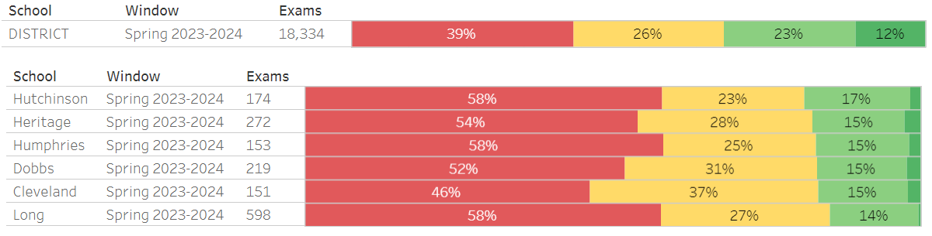
MAP Reading

Slide 5
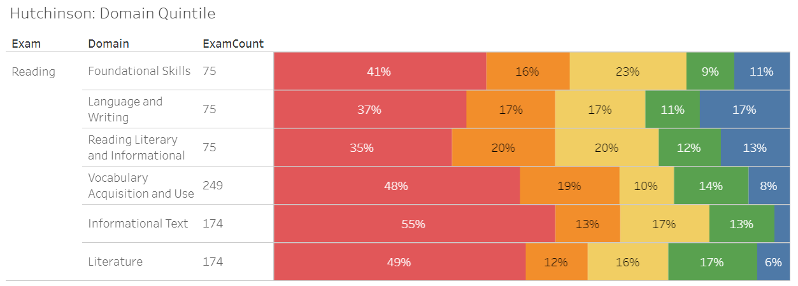
MAP Reading Domains

Slide 6
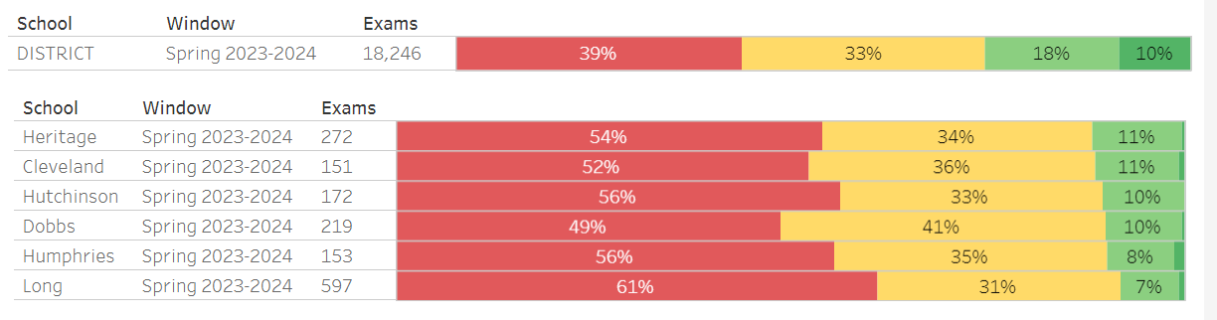
MAP Math

Slide 7
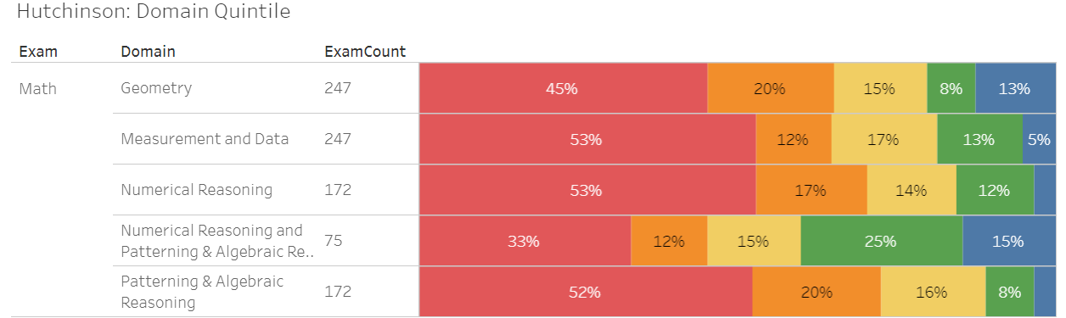
MAP Math Domains

Slide 8

Needs Assessment
Needs Assessment
During this Needs Assessment, we will look at data from the Spring MAPS administration and identify 2-3 potential needs for the 2024-2025 school year.
This discussion will help school leadership as they complete the school’s 2024-2025 Continuous Improvement Plan.
ACTIVITY

Slide 9
Needs Assessment:
Guiding Questions
What does this data tell us?
What good news is there to celebrate?
Where are growth opportunities?
What trends do we see in the data?

Slide 10
Needs Assessment:
What are two to three (2-3) needs we can identify based our data?
 | Need
1 | Reading labs starting in August, small group pull outs
2 | Collaborating with Readers are Leaders instructional coach and ELA coach
3 | Including DEAR time into the instructional schedule
4 | Math pull out with instructional coach

Slide 11
Information Items

Slide 12

Principal’s Report

Slide 13
GMAS April 29th- May 14th
Field Day May 15th and 16th
PBL STEM Night May 16th 4pm- 6pm
5th Grade Transition to Long Middle May 17th
Awards Days
  May 20th- Fifth and Fourth Grade
  May 21st – Third Grade, PreK and Kindergarten
  May 22nd – Second and First Grade
Last day for Students May 24th

Slide 14
Additional Information Items
Cluster Advisory Team Report
GO Team Elections
  Find candidates at apsstrongschools.com
  Vote APRIL 16-25
  Households are sent a unique link based upon information in Infinite Campus
  School Staff will be sent a link to their APS email address

Slide 15

Announcements
GO Team Members
  Complete your end of year surveys
    Principal Feedback Survey (AVAILABLE NOW! Check your email for the link)
    GO Team Satisfaction Survey (Available May 1st)
  Complete your required trainings ASAP
    Contact the GO Team Office with any questions

Slide 16


